Slide 1
1.1: Introduction to Biomimicry
Introduction to Biomimicry
Starter activity

Slide 2
1.1: Introduction to Biomimicry
Starter 1 — Velcro survey
Work in groups of 5-6.
Conduct a quick survey of your group to find out how many items each person has with them that have Velcro.
Group your results into different categories e.g. shoes, bags etc.
How will you record your results ?
Compare how you recorded your results with other groups.
What did you find out?
What type of graph would you use to show your results?

Slide 3
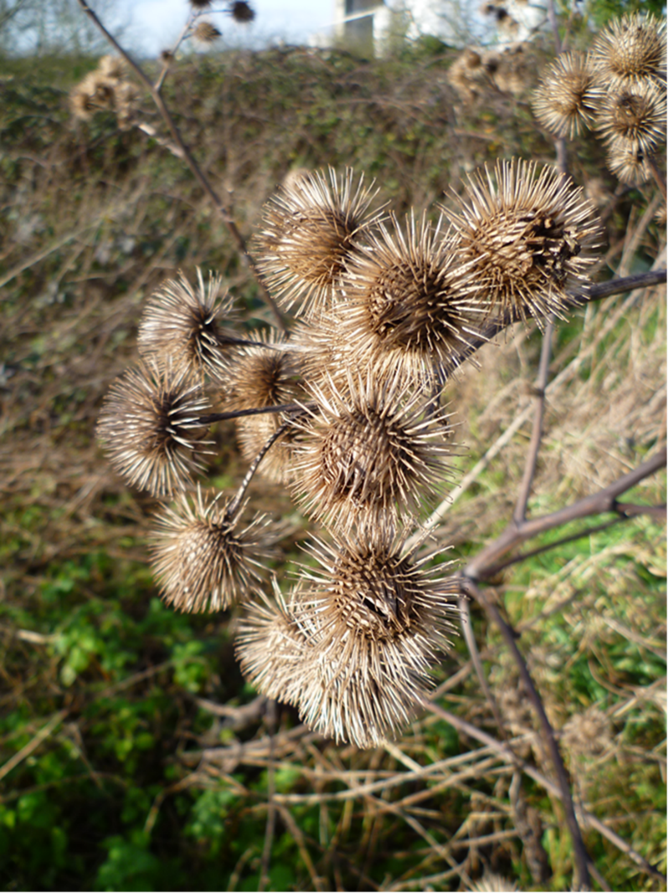
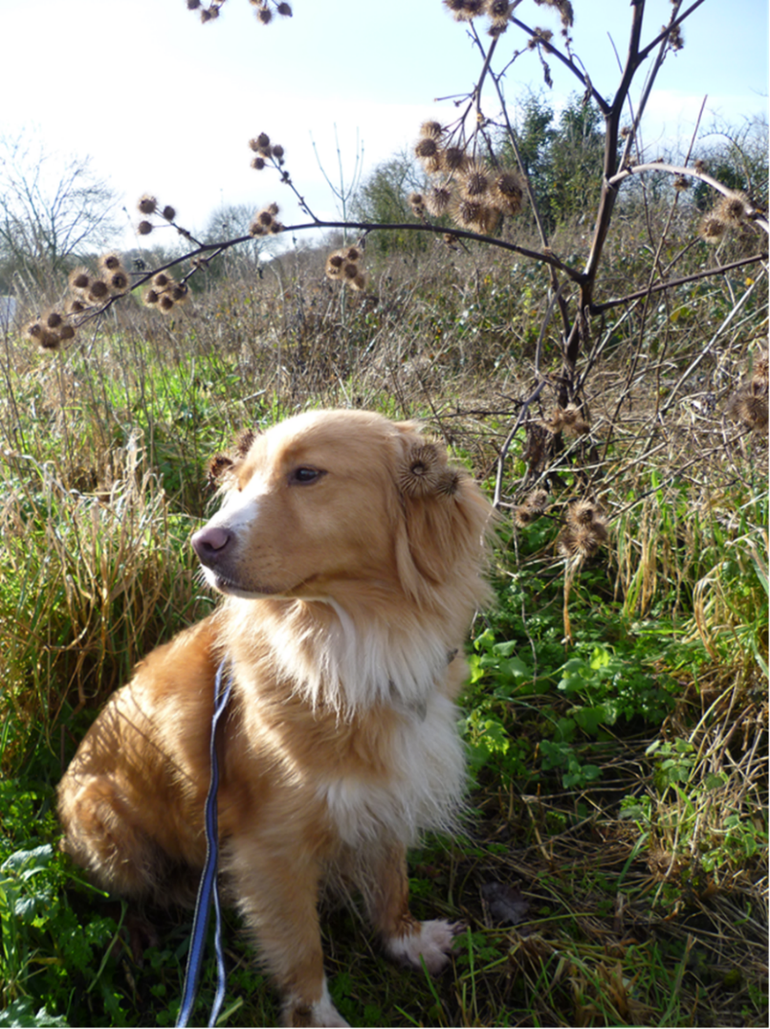
1.1: Introduction to Biomimicry
Starter 2 – History of Velcro
Does any one know the history of Velcro?
Look at these pictures. Suggest links between the pictures and Velcro.

Slide 4
1.1: Introduction to Biomimicry
Velcro was invented in 1948 by Swiss engineer George de Mestral.
Long walks with his dog often ended with George picking burrs from the hair of his dog.
He wondered why it was so 'sticky'.

Slide 5
1.1: Introduction to Biomimicry
Velcro is known as a 'hook and loop' fastener. It is based on the hooked spines of burdock seeds.
These latch onto the fur of passing animals. The seed is dragged off the plant and dispersed.
Velcro is a famous example of ‘biomimicry’.

Slide 6
1.1: Introduction to Biomimicry
Starter 3 — What is biomimicry?
Watch the TED-talk to discover what biomimicry is:
www.ted.com/talks/janine_benyus_biomimicry_in_action?language=en
Give examples of how people have looked to nature for ideas.
Notes:
The whole clip is 17 minutes long. Leave the clip after the bullet train or after the shark/bacteria section (approx. 6 minutes).

