Slide 1
Simple probability
Mathematics for GCSE Science
© 2016 AQA. Created by Teachit for AQA.

Slide 2
LO: Understand simple probability
A probability is a number that tells you how likely something is to happen.
It is useful in determining the likelihood of an event, as well as determining potential risk.
Over the course of this presentation, we will discuss the topics of simple probability, including experimental probability, expected frequency and relative frequency.

Slide 3
Probability
The probability of an outcome is a number, which can lie anywhere between
0
1
impossible
certain
We can express this number as ...
a decimal
a fraction
a percentage
$$\frac{1}{2}$$
0.5
50%

Slide 4
Probability
You can calculate probability of an outcome using a formula, as long as all outcomes are equally likely.
You could use this formula to calculate probability for the event of rolling an ordinary dice. However, if the dice was loaded so it was more likely to come up 6, then it would not be appropriate to use this formula.
Probability of an outcome = $\frac{number of ways the outcome can happen}{total number of possible ways}$
Or put another way, the probability of an outcome is the number of favourable outcomes, divided by the total number of outcomes.

Slide 5
Probability
When we roll a dice once, there are a total of 6 possible outcomes. There are 3 ways of getting an even number. Therefore, the probability of getting an even number in the event of a dice roll is:
Probability of an outcome = $\frac{number of ways the outcome can happen}{total number of possible ways}$
$$=\frac{3}{6}$$
This can be simplified to $\frac{1}{2}$
it can also be expressed as 0.5 or 50%.

Slide 6
Probability in practice
On a popular TV game show, contestants must collect gold stars.
Matt, one of the contestants, is blindfolded, and must pick out one item from the bag on the left. In it there are 5 poisonous snakes and only one gold star.
If he selects an item at random, what are the chances of it being the gold star?
There are 6 items, so 6 total possible ways.
There is only one gold star, so 1 way this outcome can happen ...
Probability of an outcome = $\frac{number of ways the outcome can happen}{total number of possible ways}$
Probability of picking gold star = $\frac{1}{6}$
= 17%, 0.17

Slide 7
Simple probability
Magical Trevor relies on chance for the success of his card tricks. He asks an audience member to pick a card randomly from the pack (there are 52 cards in the pack). If he then guesses the card randomly, what is the probability of him getting it right?
Probability of an outcome = $\frac{number of ways the outcome can happen}{total number of possible ways}$
There is 1 way in which the preferred outcome can happen, and 52 potential different ways altogether
$So, \frac{1}{52}$.
The probability is $\frac{1}{52 } \text{, 1.9\% , 0.019}\text{.}$

Slide 8
Relative frequency
Relative frequency is used to estimate probability, when there is no theoretical method of finding the probability.
We can use simple probability in the event of a dice roll, because we know the probability of each outcome ($\frac{1}{6}$) because they are equally likely, and so the chance of each is the same.
This is not the case for other events, for example the chance of a train being late.
Relative frequency = $\frac{number of times x occurs}{total number of trials}$

Slide 9
Relative frequency
A very busy station carries out a survey of its train arrival times over the course of a day, where 20 trains are expected.
Out of the first 10 trains, 2 are late.
What is the relative frequency of trains being late?
Relative frequency = $\frac{number of times x occurs}{total number of trials}$
2 out of 10 trains are late
So $\frac{2}{10}=\frac{1}{5}$
The relative frequency so far is $\frac{1}{5}$, 20%, 0.2

Slide 10
Relative frequency
Out of the next 190 trains, 48 are late.
What is the relative frequency of late trains for the whole day?
Relative frequency = $\frac{number of times x occurs}{total number of trials}$
50 out of 200 trains are late
So $\frac{50}{200}=$ $\frac{1}{4}$
The relative frequency for the day is $\frac{1}{4}$, 25%, 0.25

Slide 11
Expected frequency
Expected frequency = probability $×$ number of trials
At a certain station, the trains are often late. The probability of a train arriving late to this station is $\frac{7}{10}, or 70\%$
20 trains are scheduled today.
How many of these would we expect to be late?
$\frac{7}{10}$ $×$ 20 = 14
We would expect 14 trains to be late

Slide 12
Experimental probability
Experimental probability is different to theoretical probability.
It is putting the theory into practice.
When throwing a coin, the simple probability of throwing heads is $\frac{1}{2}$, or 50%.
Dr Scott throws a coin 10 times.
We would expect her to throw heads half the time, so the expected frequency would be 5 heads and 5 tails.
In actuality, she only throws 2 heads, so the experimental probability is $\frac{2}{10}= \frac{1}{5}$, 20%, 0.2
If she had carried out more trials, the number would lie closer to the expected frequency.

Slide 13
Experimental probability
An experimental cream is being tested on 800 mice. It cures eczema in 550 of the mice. However it causes the 250 remaining mice to suffer from insomnia, and 50 of these develop conjunctivitis.
What is the probability of the cream curing eczema on a lab mouse?
If a mouse is not cured, what is the experimental probability of them not developing conjunctivitis?
Experimental probability= $\frac{number of times specific outcome happens}{total number of trials}$
550 mice were cured out of 800
$\frac{550}{800}$ = $\frac{11}{16}$
The experimental probability of a mouse being cured is $\frac{11}{16} ,$0.68, 69%

Slide 14
Experimental probability
An experimental cream is being tested on 800 mice. It cures eczema in 550 of the mice. However it causes the 250 remaining mice to suffer from insomnia, and 50 of these develop conjunctivitis.
What is the probability of the cream curing eczema on a lab mouse?
If a mouse is not cured, what is the experimental probability of them not developing conjunctivitis?
Experimental probability= $\frac{number of times specific outcome happens}{total number of trials}$
50 mice developed conjunctivitis out of the 250 that weren’t cured
$$\frac{50}{250}= \frac{1}{5}$$
The experimental probability of an uncured mouse developing conjunctivitis is $\frac{1}{5} ,$0.2, 20%

Slide 15
Summary
Probability of an outcome = $\frac{number of ways the outcome can happen}{total number of possible ways}$
Relative frequency = $\frac{number of times x occurs}{total number of trials}$
Expected frequency = probability $×$ number of trials
Experimental probability = $\frac{number of times specific outcome happens}{total number of trials}$

Slide 16
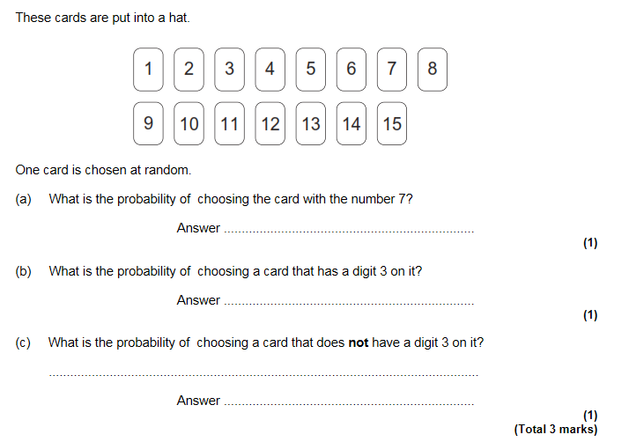
Some questions to try from
GCSE Maths F
Copyright © AQA and its licensors. All rights reserved.

Slide 17
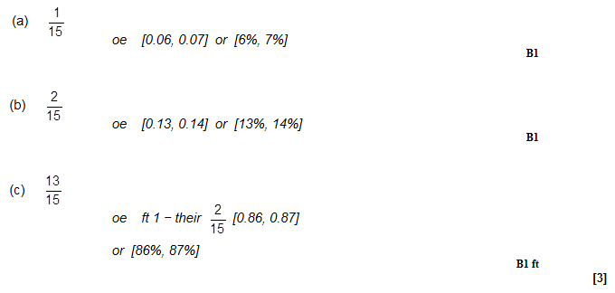
Some questions to try from
GCSE Maths F
Copyright © AQA and its licensors. All rights reserved.

Slide 18
GCSE Maths F
Some questions to try from
Copyright © AQA and its licensors. All rights reserved.

Slide 19
GCSE Maths F
Some questions to try from
Copyright © AQA and its licensors. All rights reserved.

Slide 20
GCSE Biology sample assessment materials
Copyright © AQA and its licensors. All rights reserved.

Slide 21
GCSE Biology sample assessment materials
Copyright © AQA and its licensors. All rights reserved.

Slide 22
GCSE Biology sample assessment materials
Copyright © AQA and its licensors. All rights reserved.

