Slide 1
5.3: Silk moths and chitin
Starter and plenary

Slide 2
5.3: Silk moths and chitin
Chitin and plastics
Starter activity

Slide 3
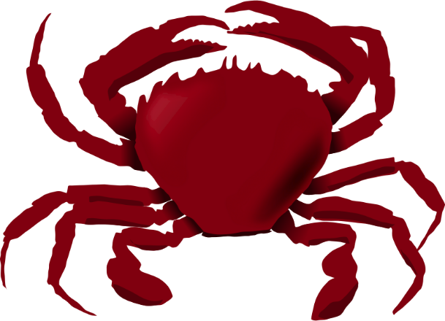
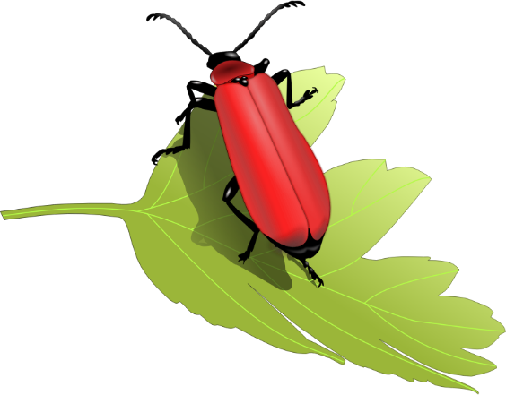
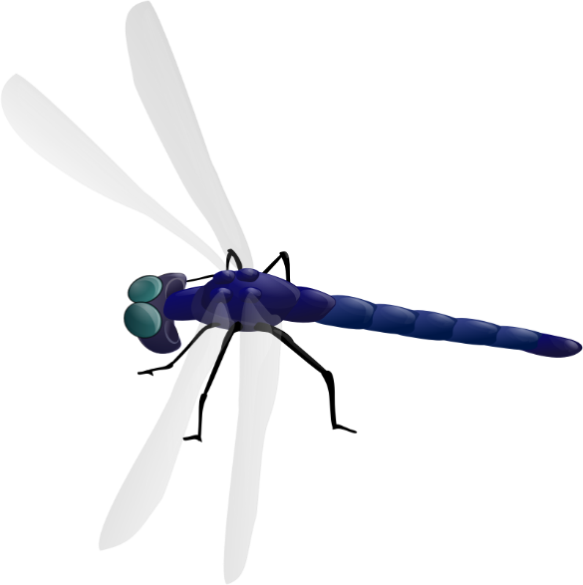
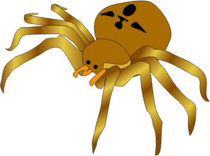
5.3: Silk moths and chitin
What do these images have in common?

Slide 4
5.3: Silk moths and chitin
They are all invertebrates. They all have an exoskeleton. The exoskeleton is made of a substance called chitin. Chitin is a polymer of a form of glucose.

Slide 5
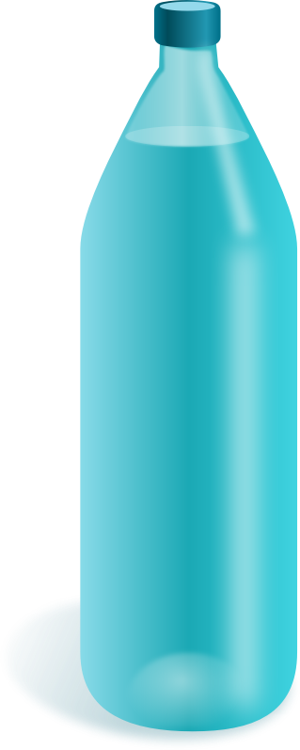
5.3: Silk moths and chitin
What do these images have in common?

Slide 6
5.3: Silk moths and chitin
They are all made of plastic. Plastics are polymers. The raw material for almost all plastics is crude oil.

Slide 7
5.3: Silk moths and chitin
Why is it that ...?
5.25 trillion pieces of plastic are currently floating in the sea.
At one spot in the Pacific, accumulated plastic is so dense a person could walk on it.

Slide 8
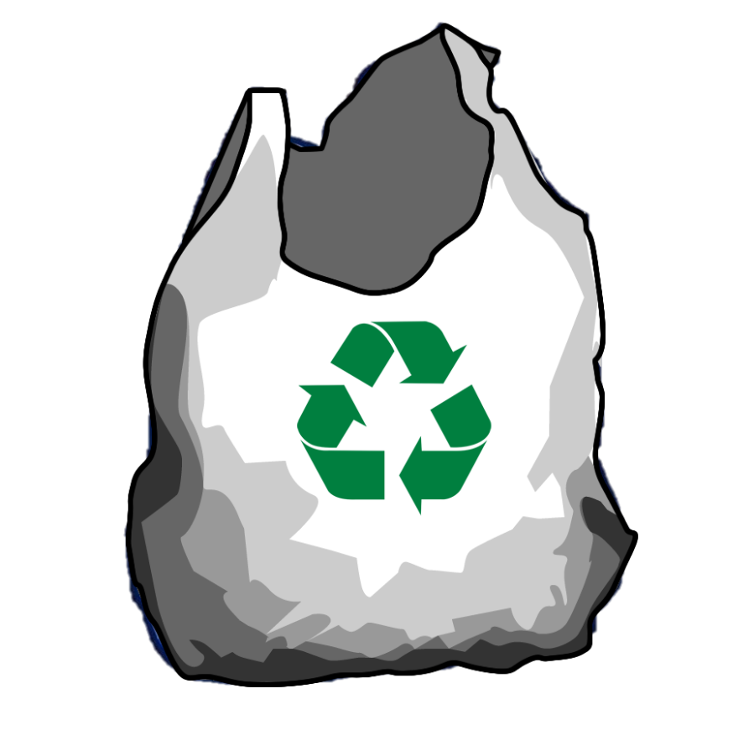
5.3: Silk moths and chitin
Answer: Most plastics are not biodegradable

Slide 9
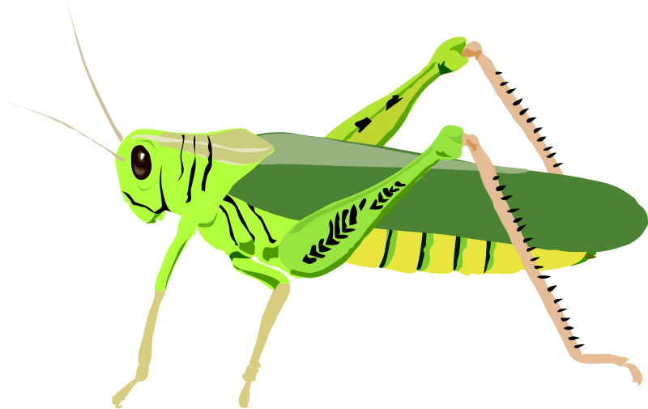
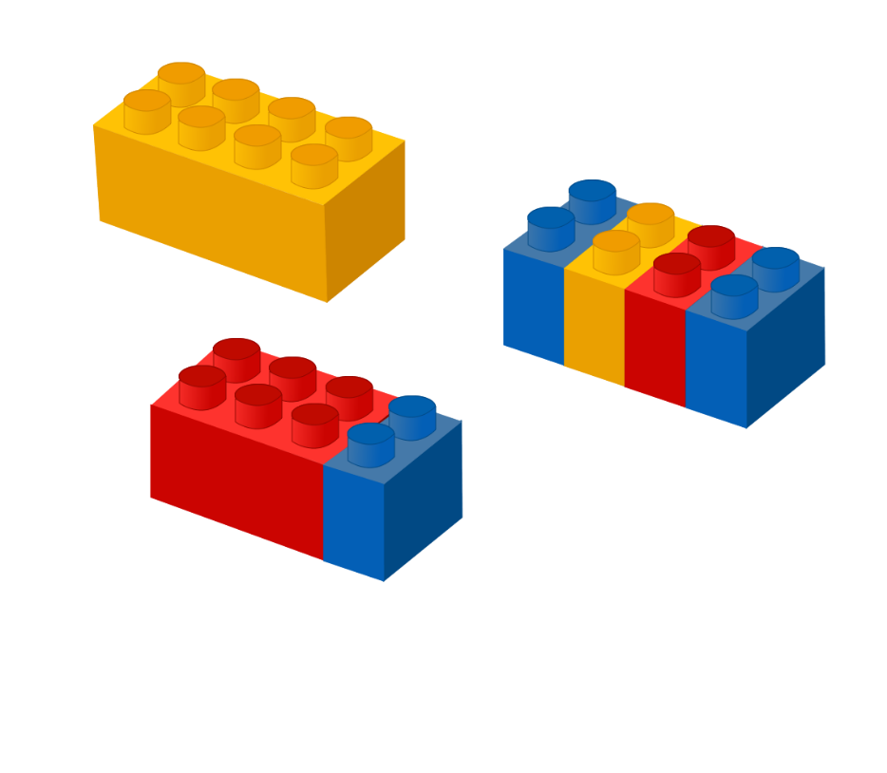
5.3: Silk moths and chitin
Can you make a connection between the images?

Slide 10
5.3: Silk moths and chitin
Match the Greek word with its meaning
Plenary activity

Slide 11
5.3: Silk moths and chitin
Match the Greek word and its meaning
Many of the words we use today have their roots in ancient languages such as Greek and Latin.
Match the words on the next slide with their meaning.

Slide 12
5.3: Silk moths and chitin
Match the Greek word and its meaning
Greek word |  | Meaning
plasticos |  | to mould
khitōn |  | relating to an organ or instrument
skeletos |  | tunic
organikos |  | having many parts
exō- |  | dried up
polumeros |  | outside

