Slide 1
3.2: Desalination
Starter 2

Slide 2
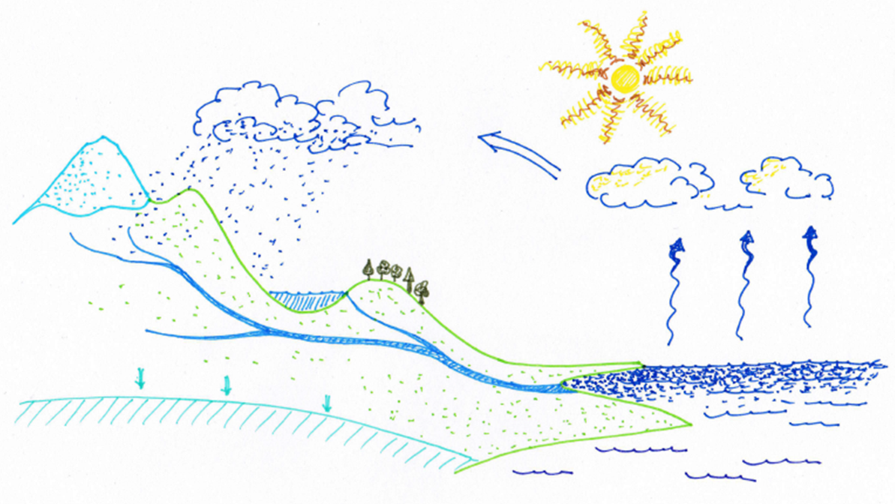
3.2: Desalination
How does nature provide us with fresh water?
aquifer
evaporation
run off
precipitation
condensation
transpiration

Slide 3
3.2: Desalination
Water cycle starter answers
condensation
precipitation
transpiration
evaporation
run off
aquifer

Slide 4
3.2: Desalination
Teaching notes
This activity is differentiated so that some students can work out the population of each country in whole numbers whereas others can work out the population in standard form.
Differentiation
Ask them to note down the name of the country and its population as a whole number or in standard form and then show the last slide to see if they can name each country from the information they have got. This should be slightly more difficult for the students who have got the population written down in standard form.

Slide 5
3.2: Desalination
Main 1 - world’s population and water

Slide 6
3.2: Desalination
Add your estimates to the table.
Country | Total population (millions) | Population without safe drinking water (millions) | Estimation of percentage of population without safe drinking water
Bolivia | 10.91 | 6.89
Botswana | 2.02 | 1.82
Burkino Faso | 17.05 | 7.16
Dominican Republic | 10.48 | 6.82
Indonesia | 249.90 | 187.50
Laos | 6.77 | 2.98

Slide 7
3.2: Desalination
Country | Total population (millions) | Population without safe drinking water (millions) | Percentage of population without safe drinking water (to nearest whole number)
 |  |  | Calculation | %
Bolivia | 10.91 | 6.89 | (6.89 million ÷ 10.91 million) x 100 | 63
Botswana | 2.02 | 1.82 |  | 90
Burkino Faso | 17.05 | 7.16 |  | 42
Dominican Republic | 10.48 | 6.82 |  | 65
Indonesia | 249.90 | 187.50 |  | 75
Laos | 6.77 | 2.98 |  | 44
?
?
?
?
?
?
Why is it helpful to use percentage values rather than the unprocessed population data?
Enables you to make comparisons between countries easily.

Slide 8
3.2: Desalination
Write down the country and its population from the third or fourth column.
Country | Total population (millions) | Population as a whole number | Population as a whole number rounded to the nearest million | Extension: Population in standard form to 2 decimal places
Bolivia | 10.91
Botswana | 2.02
Burkino Faso | 17.05
Dominican Republic | 10.48
Indonesia | 249.90
Laos | 6.77

Slide 9
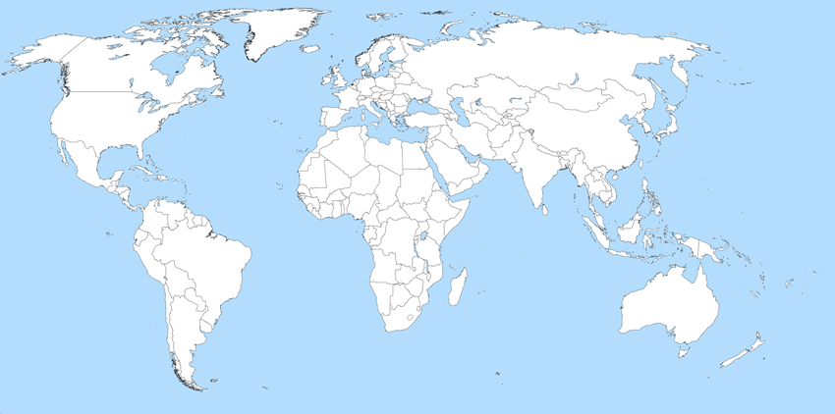
3.2: Desalination
Can you use your notes to identify each country by its population?
Click a box to check your answer.
Label the countries on your paper version of the map.
10 million
Dominican Republic
7 million
Laos
250 million
Indonesia
11 million
17 million
2 million
Bolivia
Burkino Faso
Botswana

Slide 10
3.2: Desalination
Answers
Country | Total population (millions) | Population as a whole number | Population as a whole number rounded to the nearest million | Extension: Population in Standard form to 2 decimal places
Bolivia | 10.91 | 10 910 000 | 11 million | 1.09 x 10⁷
Botswana | 2.02 | 2 020 000 | 2 million | 2.02 x 10⁶
Burkino Faso | 17.05 | 17 050 000 | 17 million | 1.71 x 10⁷
Dominican Republic | 10.48 | 10 480 000 | 10 million | 1.05 x 10⁷
Indonesia | 249.90 | 249 900 000 | 250 million | 2.50 x 10⁸
Laos | 6.77 | 6 770 000 | 7 million | 6.77 x 10⁶

Slide 11
How can scientists help solve the problem of a lack of safe drinking water using processes found in nature?
The processes, evaporation/condensation in the water cycle and osmosis, are found in nature, and are used by people to produce fresh water from salt water in a process known as desalination.
Desalination was mentioned in the video you watched for homework.

