Slide 1
2.2: What can we learn from termite mounds?
What can we learn from termite mounds?

Slide 2
2.2: What can we learn from termite mounds?
Watch the following clip of some architects explaining how
they design energy efficient buildings:
nationalstemcentre.org.uk/elibrary/resource/3287/career-clips-energy-efficiency-and-architecture
In our climate, we tend to think of warming our buildings with central heating but in many countries they need to keep their buildings cool by using ... what?
List ways of keeping buildings cool and warm.

Slide 3
2.2: What can we learn from termite mounds?
How many of the methods you listed for keeping a building warm or cool use fossil fuels?
Scientists, engineers and architects are working together to reduce the amount of fossil fuels needed to keep our buildings warm in colder climates and cool in hotter climates.
Discussion
What did you find out for home work about African mound-building termites?
What do you think the connection is to today's lesson?

Slide 4
2.2: What can we learn from termite mounds?
Watch the first 1:16 of the following clip
esf.edu/efb/turner/termitePages/termiteEndocasting.html
Termite mounds 'capture wind energy in their special way'.
What is the link to our theme of biomimicry?
Scientists investigated how a termite mound maintains a constant temperature inside the nest chamber at the base of the mound when the temperature outside the mound fluctuates between 15 °C – 30 °C.

Slide 5
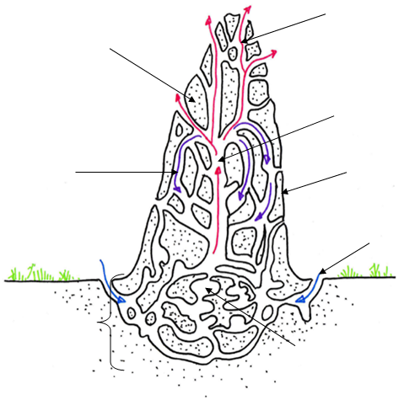
2.2: What can we learn from termite mounds?
Cross section of a termite mound
warm air rising
by convection
conduction of heat
through walls of mound
central chimney
cooler air sinking
porous surface
fresh air drawn into mound
termite nest chamber
warmed by respiration

Slide 6
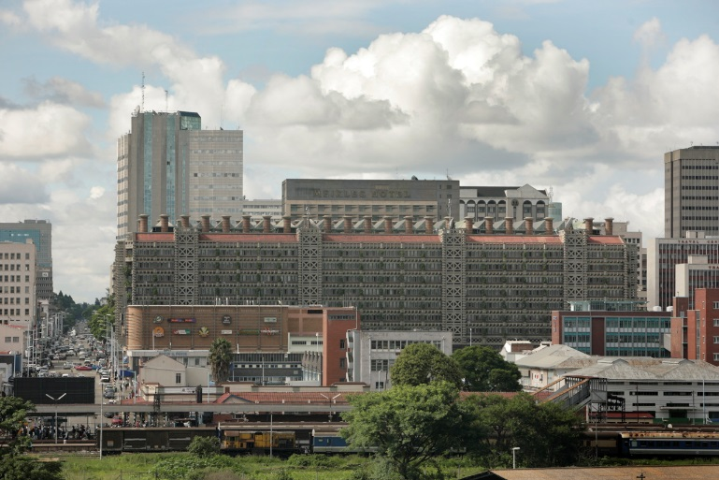
2.2: What can we learn from termite mounds?
Architect, Mick Pearce designed this building in 1993. It was based on the idea at the time that termite mounds kept cool by the convection of warm air upwards through the mound. Heat is lost from the rising air by conduction through the walls of the mound and it sinks back down as it cools.
Some of the warm rising air leaves the porous mound and fresh air is drawn into the nest at ground level.
The Eastgate centre works very well but scientists have since discovered that the movement of air inside a termite mound is much more complicated.
Notes:
Image credit: David Brazier
This image is licensed under the Creative Commons Attribution-Share Alike 3.0 Unported license.

Slide 7
2.2: What can we learn from termite mounds?
Watch first 2:12 minutes of homework clip:
youtube.com/watch?v=xGaT0B__2DM
What is the main purpose of the termite mound?
To harness the wind.
Wind has a big role. Wind hitting the windward side of the termite mound drives oxygen-rich air through its porous exterior and into the mound’s tunnels. Stale, carbon-dioxide-rich air is sucked out the leeward side.
Architect, Mike Pearce did not have this knowledge when he designed the Eastgate centre but the building still functions very well, keeping a constant cool temperature without using much air conditioning.
Q. What could scientists and architects do with this new knowledge?

Slide 8
2.2: What can we learn from termite mounds?
Watch the clip about the CH2 in Melbourne – a later design by the same architect.
You will be asked about the special features of this new design at the end of the lesson.
youtube.com/watch?gl=AU&hl=en-GB&v=N1CkwnqrYrE

